Slide 1

Currency Converter
By: Tohidul Islam

Slide 2

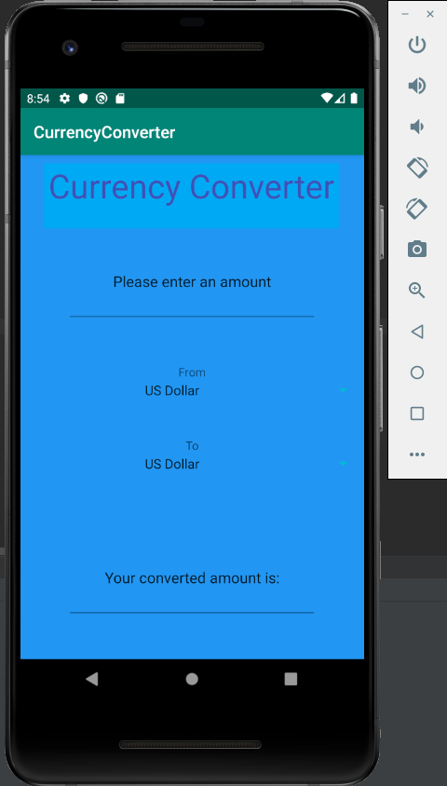
Initial Screen

Slide 3
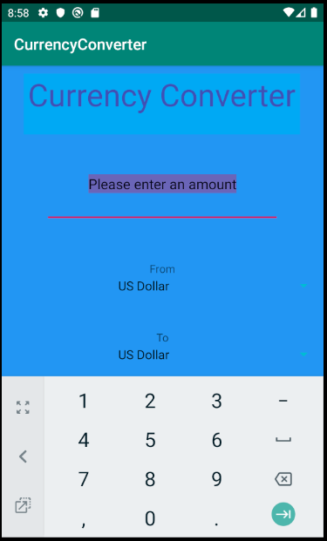
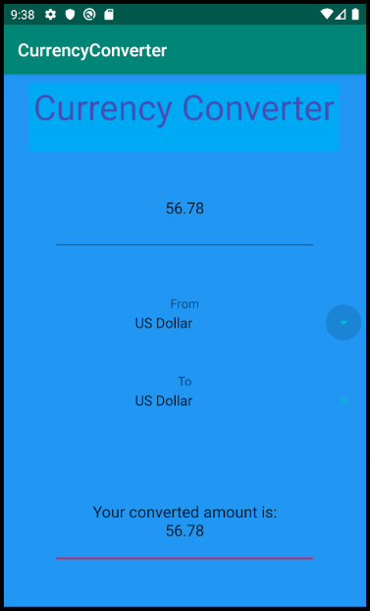
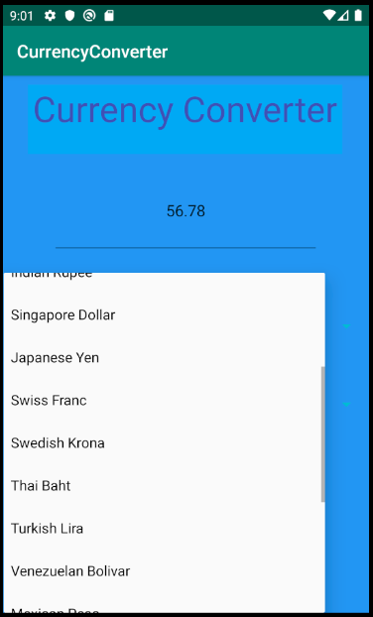
User interactions

Slide 4

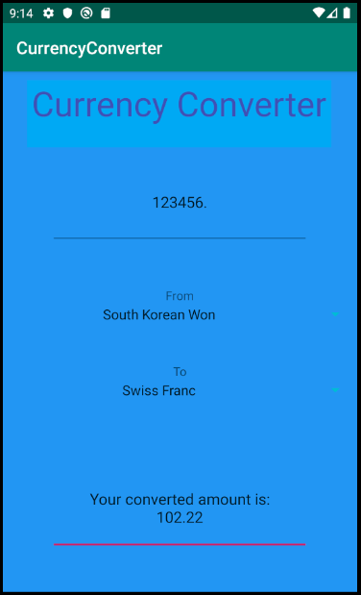
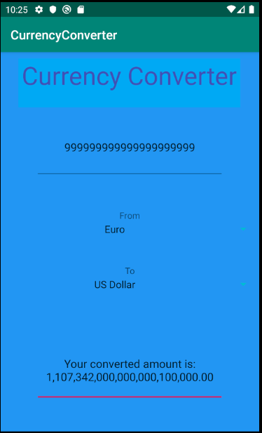
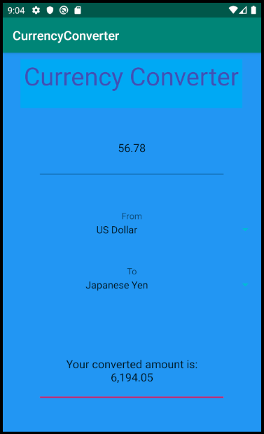
Examples

Slide 5

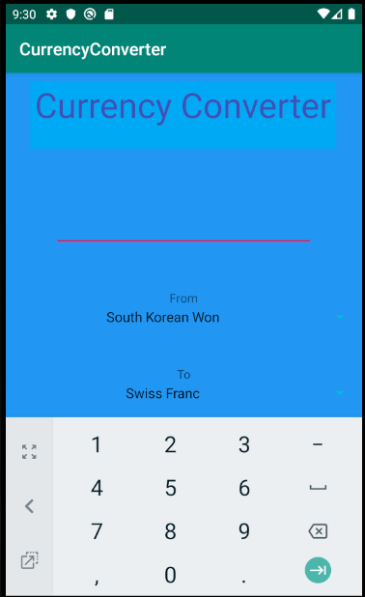
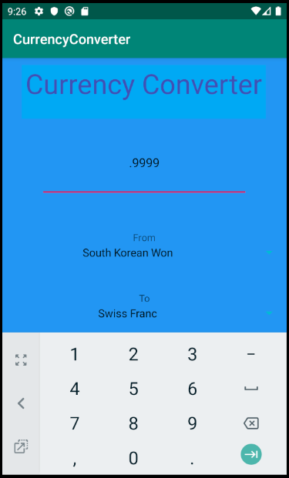
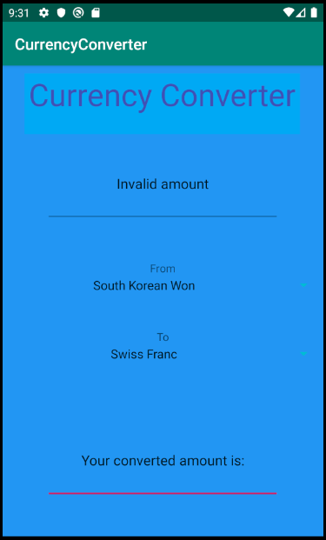
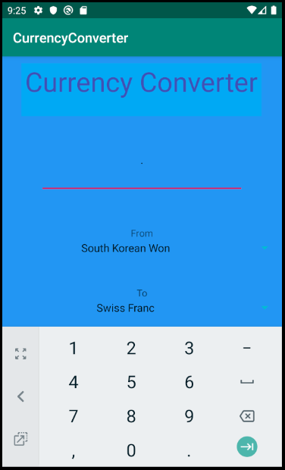
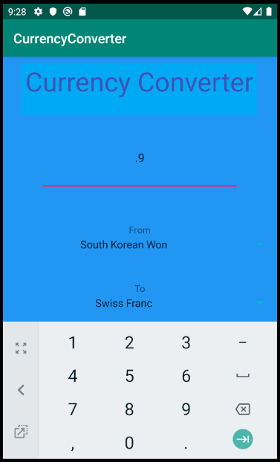
Invalid inputs

Slide 6
Challenges faced
Finding a way to populate the spinner widget with the various currencies
Extracting data from websites in html form and finding the necessary currency values
Storing the acquired data in android’s internal storage for situations where internet is not available

Slide 7
Things I have learned
How to work with android studios to design an application
How to read and write files on android devices
How to extract data from websites
How to use xml to represent strings and a list of currencies

Slide 8
What I would have liked to add
A full list of currencies dynamically created from the information extracted from the websites
Currency symbols for each currency type in the text fields and dropdown menus
A more sophisticated design for the interface
Additional features such as a top 5 chart displaying the five currencies with the biggest change in value since the user has last used the app. Obtained by comparing newly obtained data from websites with the data in internal storage

Slide 9
Thank You

Slide 10

Additional slides for phase ii submission

Slide 11
Summary of features implemented
Highlights input box text on touch to allow easy text replacement
Validation of user input (I did not put a cap on the amount of numbers that users can input)
User chosen starting and target currency types
33 different currency types with rates derived from a public online api
Formatted output calculated from recent currency rates
Stores rates from most recent app launch with internet into shared preferences (I limited the number of data retrieval attempts to just once at app launch to avoid misusing the free-to-use api, so the app will not update rates if internet is turned back on after app launches without internet, user would need to close the app and reopen it)
Applies old rates from storage when it detects that internet data retrieval has failed
Displays a message in the output field when there is no saved data and internet, and when there is no internet but there is saved data
Keeps output text field constantly updated after a valid user input in the text field so that the user can freely swap between currency types and see the conversion without needing to press a button

Slide 12
Additional Features implemented since presentation

Slide 13
Most current rate retrieval from internet using a public, free to use, api (33 different currencies, 1089 different conversions possible) I decided to switch over from webscraping with jsoup after finding this api because it offers only the rates with no methods of its own which is what I was looking for. (https://exchangeratesapi.io/)

Slide 14

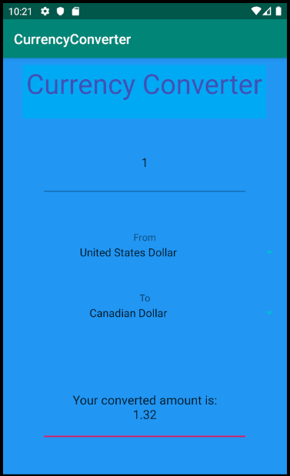
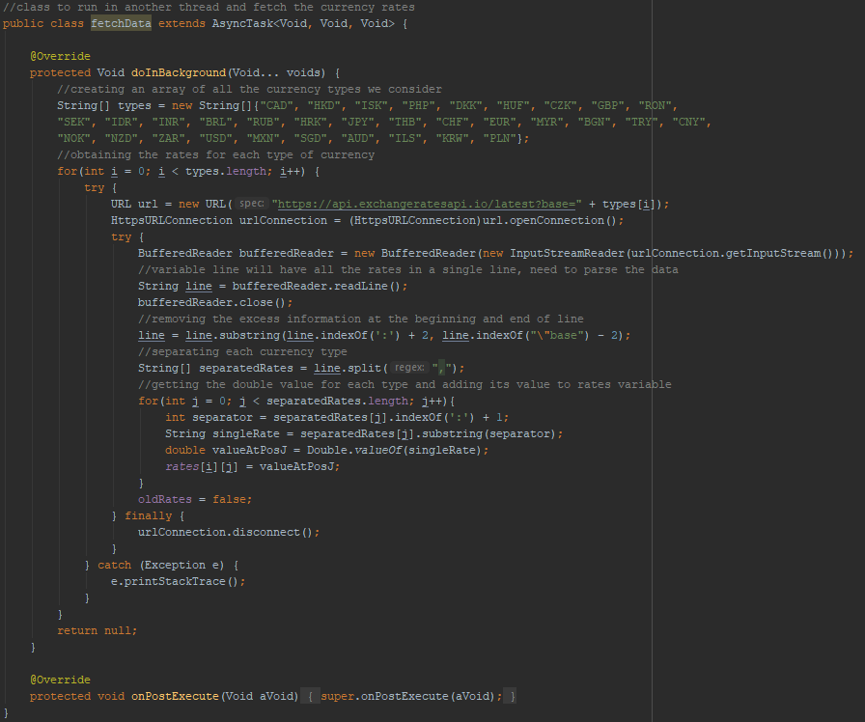
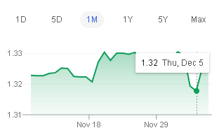
Screenshots of data retrieval

Slide 15
A method to check if the app was able to retrieve data from the internet, and if not then it checks to see if there exists any rates stored in android’s sharedpreferences , if no data exists then the user has opened the app for the first time and is prompted to restart the app with internet on, if data exists then it is loaded and used for the conversion, the app will always warn users when it is using old rates. If the app was able to retrieve data from the internet then that data is saved to sharedpreferences for future cases with no internet

Slide 16
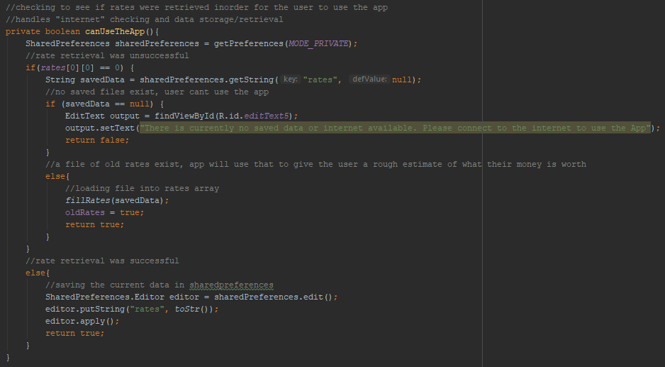
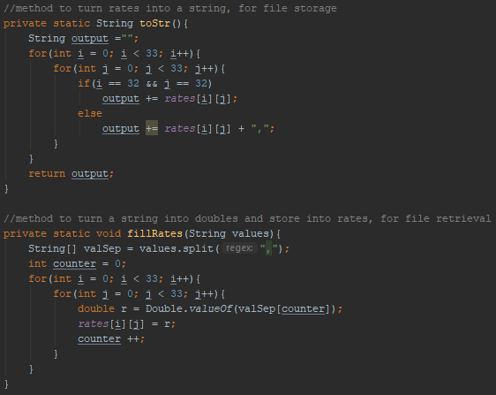
Screenshots of the “internet”/data method

Slide 17
Why I used shared preferences
The save/retrieval methods that I used belongs to android’s built in shared preferences class which allows easy storage and reading of stored data while the app is running; due to the shared preferences’ apply() method being asynchronous and running in a separate thread. This lets me store data without greatly affecting or stopping the functioning of the app, I believed it was the best storage option compared to other built in storage methods.

Slide 18
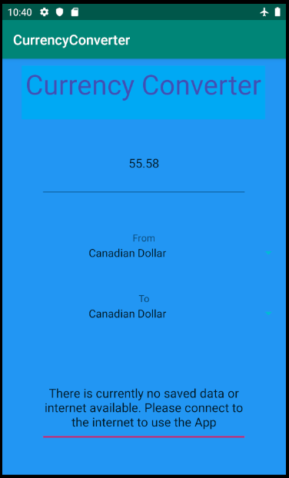
Output when user first opens the app without internet (tested by uninstalling the app from the emulator and then reinstalling after turning on airplane mode)

Slide 19
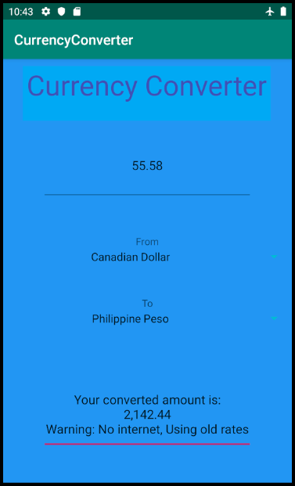
Output when the user opens the app without internet, but has previously used the app (tested by opening app once with internet then closing app and reopening with airplane mode on

Slide 20
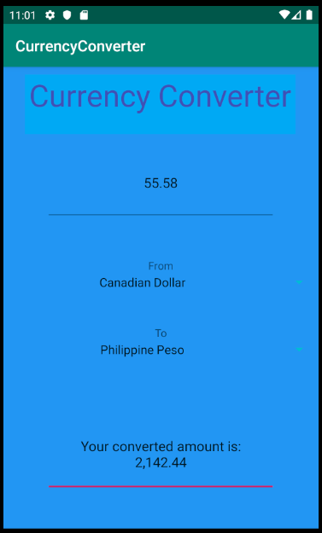
Normal output with internet on at app opening

Slide 21
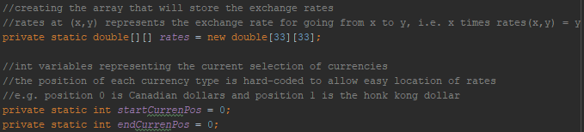
The only data structure used was a 2d array of type double to store the rate values (1d string arrays are used in the string to 2d array conversion method for data retrieval) Only a 2d array was used because it provided the fastest and easiest way to store and retrieve data for each pair of currencies.

Slide 22
There are no Missing features. The app successfully: takes user input, validates it and displays an appropriate message if the input is invalid, provides an output computed from user selected currencies, highlights input text field upon touch to allow for easy text replacement, retrieves and stores data to sharedpreferences, displays the appropriate messages depending on internet/data status, prevents the user from interacting with the output field, retrieves recent currency exchange rate data from an online api, and keeps the output field constantly updated after a valid input so that the user can just swap currencies without needed to press a button to see the conversion

Slide 23
How I overcame the challenges
I overcame the challenge of populating the spinner widget by reading the documentation for the ArrayAdapter class in developer.android.com and trying to understand how to use this to initialize my dropdown menu with the right values
I overcame the challenge of extracting data from the internet by switching over to an api which made data retrieval less time consuming than webscraping and provided an easy way to iterate between the rates for each currency type, it also allowed me to increase the number of currencies that my app supports
I overcame the challenge of storing and retrieving data by using android’s SharedPreferences to easily store and retrieve data as an xml file when needed instead of using android’s internal storage.

